Slide 1
Establishing a Just, Learning Culture
Kypton Lantz September 18, 2025 CSD380-O307 DevOps (2261-DD) Module 9.2 Assignment

Slide 2

INTRO
What is a just culture?
Definition: A culture that balances learning from incidents with fair accountability
By focusing on systems and process fixes over individual blame, Just Cultures enable honest incident reporting, blameless postmortems, faster learning, and safer continuous delivery.

Slide 3
Why it matters
Enables truthful incident reports and complete postmortems
Leading to better root-cause fixes
Encourages psychological safety
Engineers are more likely to run experiments and recover faster
Reduces hidden technical debt caused by fear-driven shortcuts
Promoting progress across the board

Slide 4
Top-level barriers
Staffing, SLAs, and speed-over-safety incentives place undo constraints on teams
BLAME & FEAR
People hide problems to avoid punishment
LACK OF LEADERSHIP
Mixed signals, inconsistency, or lack of role-modeling can kill trust
MISALIGNED CONSTRAINTS
HR, regulators, or union rules push discipline
OPERATIONAL PRESSURE
POOR DYNAMICS
Toxic team dynamics negatively affect psychological safety
LACK OF TRAINING
Unsuitable training or clarity on accountability vs. negligence causing insecurity or reluctance
These are some of the ones that actually stop a just culture from taking root.

Slide 5
Dive deeper:
Policies
Disciplinary policies that default to punishment
When HR or legal demand sanctions, people won’t report.
Constraints
Regulatory/contractual constraints
In highly-regulated environments legal exposure or audit requirements cause conservative punitive responses.
Incentives
Measurement & incentives misalignment
Metrics that reward “zero incidents” without context incentivize hiding.
Example: uptime-only bonuses that discourage honest postmortem reporting.
ORGANIZATIONAL & POLICY BARRIERS

Slide 6




Dive deeper:
PEOPLE & TEAM BARRIERS
Fear, reputation risk, and cognitive bias (blame attribution)
People assume error = incompetence
They self-protect
Quick Fix: explicit psychological-safety training and leadership modeling
Inconsistent leader behavior
If leaders punish once, all trust evaporates
Quick Fix: documented rules for when accountability is disciplinary vs. systemic

Slide 7



HOW WE GET THERE
Blameless postmortems
Audit policy language
Train leaders & align incentives with metrics
Formalize a standard template and shared improvements backlog
Adopt a clear decision flowchart so outcomes are transparent and predictable
Train leaders on psychological safety and how to run blameless reviews
Reward learning, not just “no incidents”
Remove automatic-punishment clauses for honest reporting
Involve legal and HR early

Slide 8
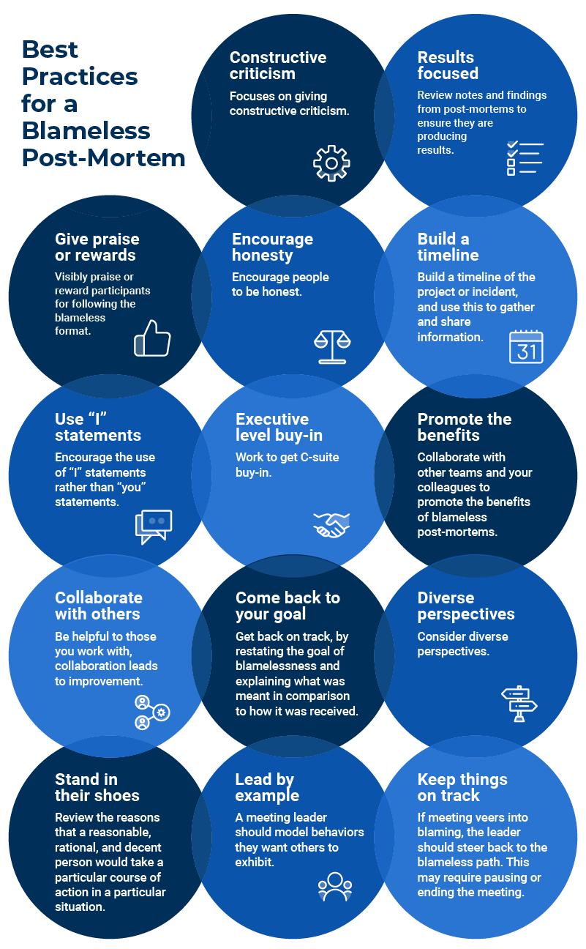
SUMMARY
A just culture in DevOps focuses on learning from failures instead of blaming individuals. Common barriers include fear of punishment, inconsistent leadership, restrictive policies, and low psychological safety, all of which discourage honest reporting. Blameless postmortems, clear accountability frameworks, leader training, and incentives that reward learning help teams overcome these challenges, enabling faster recovery and continuous improvement.

Slide 9
references
Murray, J. S., et al. (2023). Requirements for implementing a 'just culture' within healthcare organisations. BMJ Open Quality. https://bmjopenquality.bmj.com/content/12/2/e002237
Atlassian. (n.d.). How to run a blameless postmortem. Atlassian. https://www.atlassian.com/incident-management/postmortem/blameless
Google SRE. (n.d.). Postmortem culture. Google SRE Workbook. https://sre.google/workbook/postmortem-culture/
Just Culture HQA. (n.d.). Overcoming barriers to a just culture. https://justculture.hqa.ca/overcoming-barriers-to-a-just-culture/
AHRQ / PSNet. (n.d.). Making Just Culture a Reality: One Organization’s Approach. Agency for Healthcare Research and Quality. https://psnet.ahrq.gov/perspective/making-just-culture-reality-one-organizations-approach

Slide 10
THANK YOU
Kypton Lantz CSD380-O307 DevOps (2261-DD) Module 9.2 Assignment

